Slide 1

BioMill Galilee Ltd.
IMPACT INVESTMENT BRIEF · 2026
🌍
Climate Mitigation
Every tonne processed avoids ~1.8t CO₂e vs open burning
Turning the World's
Pruning Problem
into Food Security
🌾
Food Security
Ruminant roughage from waste — closes the global feed gap
MycoFeed™
♻️
Circular Economy
Disposal liability becomes premium agricultural input
Any source. One product. Negative input cost.
Erez Ashkenazi · erezsnz@gmail.com · +972-52-830-8978

Slide 2
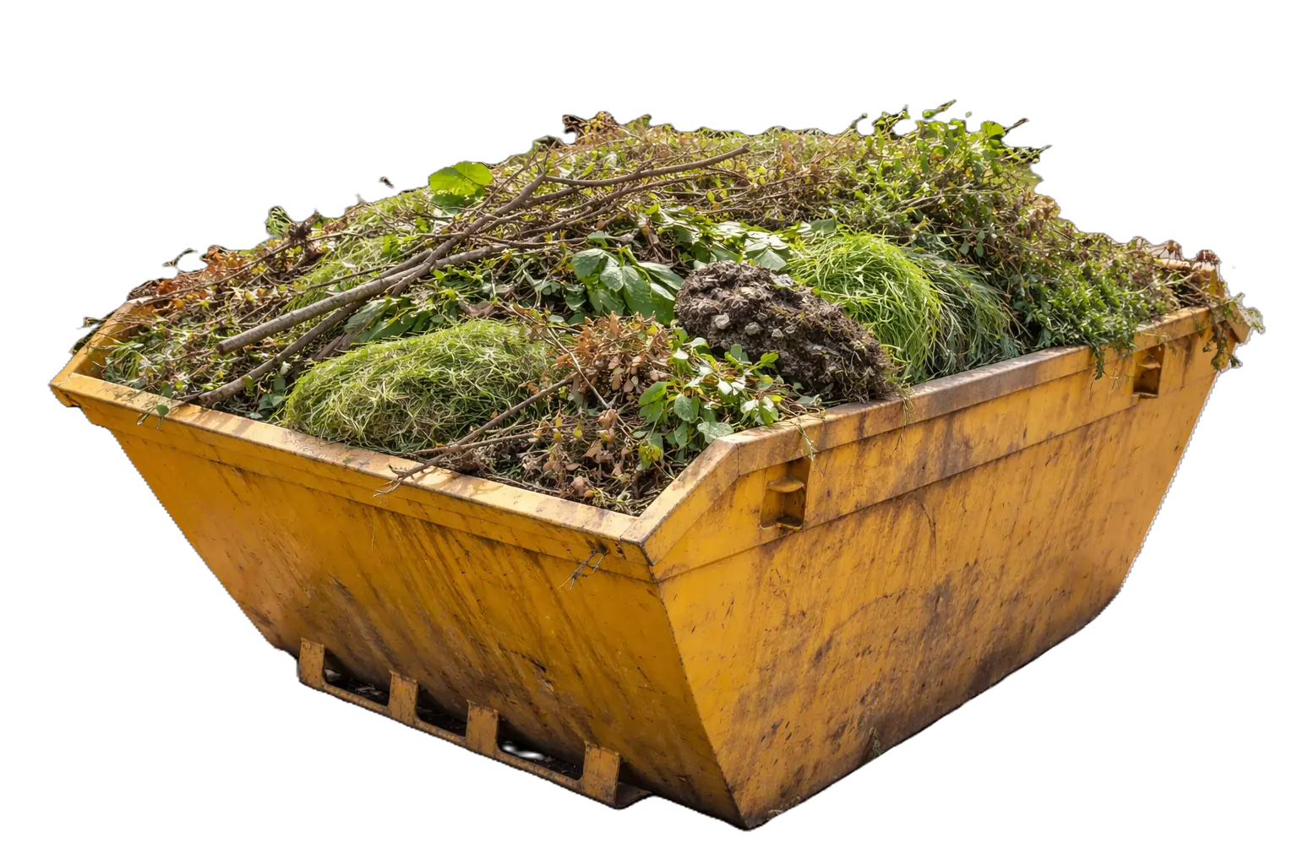
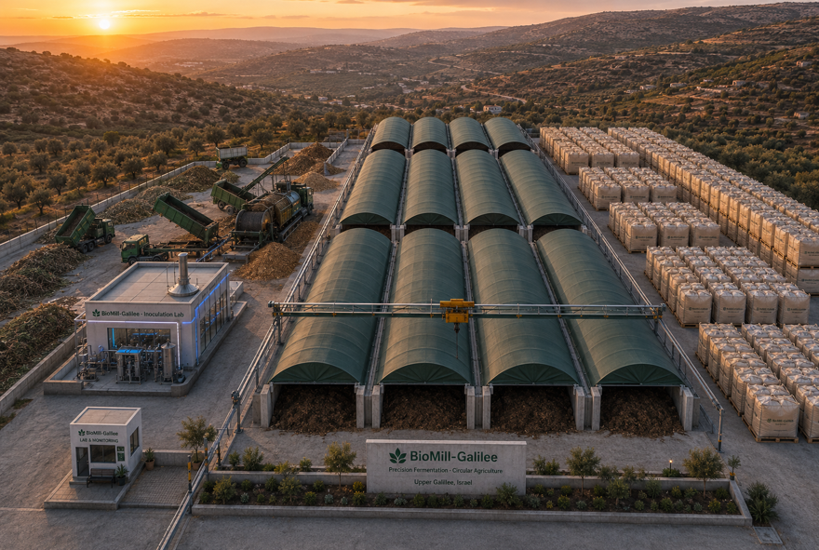
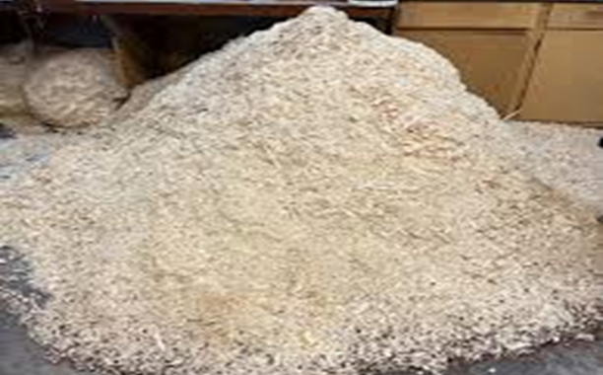
We make food from waste
🪵
⚙️
🌾
PRUNING WASTE
BioMill PROCESS
MycoFeed™
~1 billion tonnes
generated annually
worldwide
→
30-day outdoor fungal
SSF · patented · farm
scale · any feedstock
→
Verified ruminant
roughage supplement
≥70% digestibility
92 peer-reviewed studies confirm the biology. The engineering has never been done outdoors at farm scale. That is BioMill’s innovation

Slide 3
The world grows roughage on irrigated land.
At the same scale.
The same world pays to burn the exact same material.
THE FEED GAP
THE WASTE MOUNTAIN
$40B+
~1B t/yr
receives
waste — paid
to take it
→
per year in global roughage trade
lignocellulosic pruning waste generated globally
BioMill
· 1.3 billion+ cattle, sheep, and goats need continuous roughage supply
· Same cellulose-lignin polymer ruminants need — just unprocessed
· Ruminant gut function requires 30–35% dietary fibre — non-negotiable
MycoFeed™
· Cities, municipalities, orchards: pay $100–400/t to dispose of it
30-day outdoor
SSF process
· Alfalfa grown on scarce irrigated land, shipped thousands of miles
· Open-field burning illegal in California 2025, restricted across EU
· Saudi Arabia, GCC, Israel: 100% import dependent — no domestic alternative
· Zero commercial-scale biological processing solution exists globally
converts
pruning waste
into this
←
· Prices rising as water-intensive alfalfa is banned in producing regions
· 15M t/yr in Mediterranean Europe alone — burned with zero recovery
One side of the world pays to grow it. The other side pays to get rid of it. Same scale. Same material. BioMill converts the second into the first.

Slide 4

~1 Billion Tonnes of Pruning Waste Generated Every Year
Zero Commercial-Scale Solutions
Mediterranean Europe
15M t/yr
EU PRESSURE
California, USA
1.2M t/yr
India
BURN BAN 2025
Saudi Arabia / GCC
35M t/yr burned
Date palms
22% FEED DEFICIT
ALFALFA BAN 2027
Brazil
200M t/yr bagasse
WORLD'S LARGEST BEEF
Cities, farms, and utilities on every continent pay to get rid of this waste. Nobody has built a commercial-scale solution. BioMill is the first.

Slide 5
Two Crises - One Solution
Both problems exist on every continent simultaneously — and BioMill resolves both with a single process.
CRISIS 1
CRISIS 2
Global Pruning Waste
& Burning
Global Roughage
Shortage
~1B t/yr
pruning waste generated globally — no destination, no value
$40B+
annual global alfalfa trade — rising every year
ONE
SOLUTION
15M t/yr
olive & orchard prunings burned in Mediterranean Europe alone
100%
of roughage in the GCC, Israel, and arid MENA imported
↓
↑
1.8t CO₂e
released per tonne of pruning waste burned in open fields
BioMill
2027
Saudi Arabia banning domestic alfalfa production — structural gap opening
Illegal
California burn ban in force since Jan 2025 — no affordable alternative
Zero
commercial domestic roughage production in most arid-region markets

Slide 6
The Technology
BioPrep™ · MycoSSF™ · 30 days · Farm scale · Any pruning waste · Patent pending
INPUT
STAGE 1
STAGE 2 · CORE IP
OUTPUT
BioPrep™
MycoSSF™
MycoFeed™
🪵
⚗️
🍄
🌾
Pruning
Waste
Alkaline
Thermophilic
Conditioning
Outdoor Fungal
Bioconversion
Verified
Ruminant
Roughage
Any source
Municipal
Agricultural
Utility
Industrial
→
→
25 days
→
5 days
≥70%
IVDMD — in vitro digestibility
Proprietary pH
activation protocol
Proprietary temperature regime
Hygienisation
certified
Proprietary strain
selection protocol
Proprietary aeration system
Outdoor inoculation
procedure — novel
≥30%
Klason lignin reduction
100%
Ergosterol fingerprint confirmed
Lignin
20–35%
Low
digestibility
Zero
Novel product approval needed

Slide 7
Quantified Impact
Per installation at full commercial scale (30,000 t/yr MycoFeed™ output) — then multiplied globally
🌍 Climate
🌾 Food Security
♻️ Circular Economy
~90,000
30,000
$0
tCO₂e avoided / yr
tonnes of roughage / yr
raw material cost
· Eliminates open-field burning of ~58,000 t/yr waste
· Closes the domestic roughage gap in any market
· Waste disposal liability → premium food input
· Replaces shipped alfalfa (transport emissions)
· Supply immune to shipping disruption or geopolitics
· Gate fee income from Day 1, before any batch runs
· Lower enteric methane per litre of milk
· Established feed category — no novel approval
· Zero liquid effluent · zero toxic byproducts
· Zero-energy process — ambient temp, no refrigeration
· Same technology replicates globally without re-approval
· Residual substrate returns to soil as organic matter

Slide 8
Five Markets. Five Gate Fees. One Product.
Each market has documented regulatory urgency and a funded demand for MycoFeed™. Development in Israel — opportunity is global.
Market
Waste Scale
Urgency Trigger
Roughage Demand
Gate Fee Model
Mediterranean Europe
15M t/yr
EU burning rules tightening
Italy, Spain, Greece dairy sector — 100% import dependent
Gate fee forming as burn permits restricted
pruning / ag waste
California, USA
1.2M t/yr
⚡ Burn ban in force — January 2025
Largest US dairy state — alfalfa shipped 500+ miles
Growers pay $100–300/acre today — our gate fee is ready
pruning / ag waste
Saudi Arabia & GCC
33M+ date palms
⏰ Alfalfa ban 2027 — structural gap opening
Al Safi / Almarai / Nadec — world's largest dairy farms
Date palm rachis = BioMill's pilot feedstock. Perfect fit.
pruning / ag waste
India
35M t/yr burned
22% national fodder deficit · $164M govt program
World's largest milk producer — roughage shortage every dry season
Govt paying farmers not to burn — gate fee model proven
pruning / ag waste
Brazil
200M+ t/yr bagasse
Seasonal roughage shortage every dry season
World's largest beef exporter — 219M cattle
Sugar mills pay for disposal — gate fee model ready to deploy
pruning / ag waste

Slide 9
One Input. Three Revenue Streams.
No conventional feed producer has any of these three simultaneously. Per installation at full scale.
1 · Gate Fee
2 · MycoFeed™ Sales
3 · Carbon Credits
~$70/t
~$140/t
$30–50/t
CO₂e
on intake
on delivery
upside — not in base model
Generator pays BioMill to collect and process the waste.
Paid before a single batch runs.
Structural: the generator has a legal and logistical obligation to dispose of this waste regardless of commodity prices.
Verified ruminant roughage supplement delivered to farms.
Established feed category — no novel approval.
Competes with imported alfalfa at $250–500/t in most markets.
Every tonne of pruning waste processed instead of burned avoids ~1.8t CO₂e.
Voluntary carbon markets: $30–50/t CO₂e.
200,000 t/yr processed = ~$10–18M additional revenue.
Not in our financial model yet.
Combined revenue per installation at full scale: ~$7M/yr · 36% EBITDA · Payback under 3 years · Replicable globally without re-engineering

Slide 10
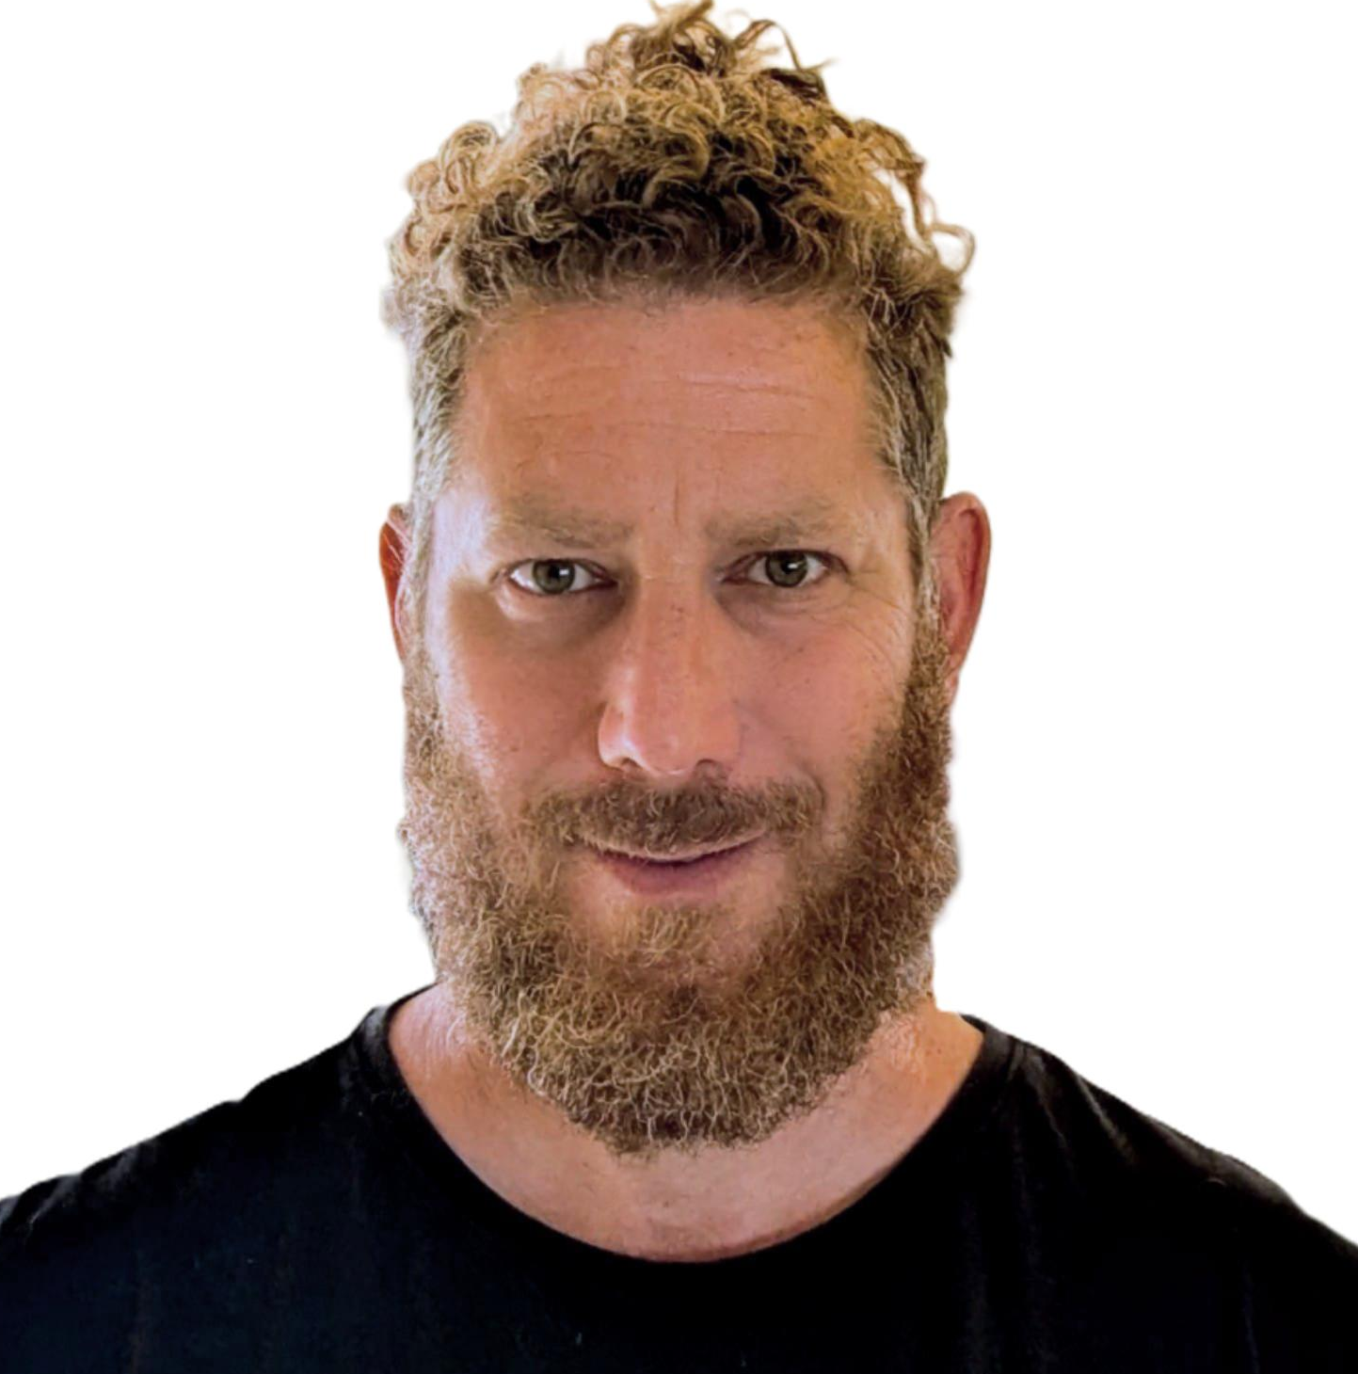
Clean Two-Founder Structure —
Full Commercial Freedom
No external equity at founding. Commercial partners aligned by interest, not cap table.
Erez Ashkenazi
Pini Marco
CTO & Co-Founder
COO & R&D · Co-Founder
CollPlant (NASDAQ) · Yemoja (Co-Founder & CEO) · 20+ years scale-up · bioprocess commercialisation
Yemoja VP R&D (Co-Founder) · 14+ years bioprocess R&D · solid-state fermentation specialist · purification systems
COMMERCIAL PARTNER
COMMERCIAL PARTNER
COMMERCIAL PARTNER
Shamir Research Institute
Ardom Agri Cooperative
Ambar Group
R&D Facility Agreement
Feedstock Partnership Agreement
MycoFeed™ Offtake Agreement
Site · autoclave · lab · analytics. BioMill owns all IP.
Pruning waste supply (agricultural + municipal). Gate fee logistics.
30,000 t/yr committed purchase. Aligned by commercial interest — not equity.
10–15% option pool · authorised before Seed · SHA: deadlock resolution, ROFR, drag/tag, 4-year vesting 1-year cliff · MycoFeed™ trademark filed at incorporation · Shamir, Ardom, Ambar hold no equity — contractual rights only

Slide 11
The Ask — €2.5M Seed · Non-Dilutive Grants · Impact Capital
Develop in Israel. Prove globally. License everywhere. Two founders, clean structure, commercial agreements in place.
USE OF FUNDS
IMPACT CAPITAL TARGETS
€100K
Pilot infrastructure (8 × outdoor bioreactors at Shamir site)
Grants (non-dilutive)
· EIC Accelerator — up to €2.5M grant + €15M equity · Israeli eligible ·
Sept 2026 call
€420K
24-month pilot OPEX (technician, analytics, consumables, regulatory)
· PRIMA — Mediterranean food systems · Israeli institutions eligible
· BIRD Foundation — Israel–US bilateral R&D · up to $1M
€90K
Patent application (provisional + full, filed before first publication)
· Horizon Europe — circular bioeconomy · climate-smart agriculture
Impact VCs
€1.89M
R&D operations, SSF partnership, first commercial farm deliveries
· Mirova (France) — €28B AUM · agri-food + climate mandate
· Astanor Ventures (Brussels/NYC) — food system transformation
· Lowercarbon Capital (US) — climate, circular, food systems
Gate 2 target: ≥30% lignin reduction · ≥70% IVDMD · first commercial deliveries
· S2G Ventures (US) — food & agriculture, California market
Erez Ashkenazi · CTO & Co-Founder · BioMill Galilee Ltd. · erezsnz@gmail.com · +972-52-830-8978 · Upper Galilee, Israel

Slide 12
Appendix

Slide 13
The Biotechnology Innovation
Four engineering challenges between lab-scale SSF and outdoor industrial process
1
Gas exchange & aeration
2
Industrial-scale inoculation
Forced aeration for outdoor 50-tonne SSF
Homogeneous spawn distribution at 50-tonne batches
Design CASP system maintaining >5% O₂ through variable-density wood chip piles
Tractor-operated inoculation achieving uniform Pleurotus coverage through irregular chips
Adapt duty cycles seasonally — summer heat management vs winter growth window (20–28°C)
Close the contamination window — establish Pleurotus dominance before Trichoderma colonises
Reversible aeration for temperature uniformity + biofilter for odour control
Spawn quality protocols: outdoor viability, large-batch prep, application rate monitoring
3
Pre-treatment standardisation
4
Agro-mechanical scale-up
Normalizing heterogeneous feedstock for consistent SSF
Farm-operable bioprocess — tractor driver, not microbiologist
Incoming waste: moisture 35–65%, particle size 8–40mm, C:N 50:1–120:1, pH 5–7
Full workflow: chipper → mixing → bay loading → cover → aeration switching → discharge
Ca(OH)₂ dosing adjusted in real time — target pH 8.5–8.7, moisture 65–70%
Modular bunker design: integrated aeration floors, leachate drainage, HDPE cover system
Seasonal SOPs: achieve 55–65°C hygienization across summer and winter conditions
Bioprocess thresholds (O₂, temperature, moisture) translated into simple agricultural SOPs
The thesis: 92 studies prove the biology. The innovation is making it work in a concrete bunker, with a tractor, in the Galilee, across seasons.

Slide 14
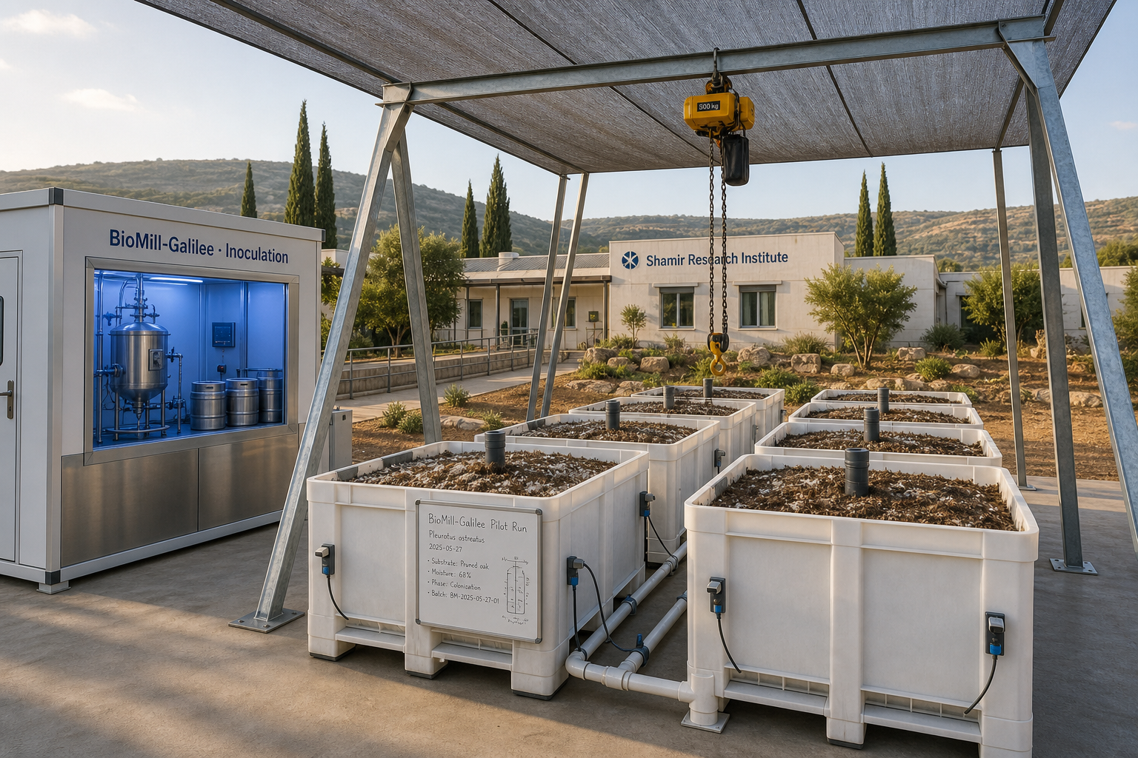
BioMill Pilot Unit Illustration

Slide 15
Key specifications & components
Bunker
25 m × 8 m × 2 m walls · 1 m substrate · 1 m headspace · footprint scales for 50–200 t batch
Cover
Sealed tensioned tarp · controlled atmosphere · tie-down at corners
Aeration
5 channels in floor · forced air via centrifugal blower · 50–300 mL/min·kg DM
Humidification
Water scrubber humidifier on blower inlet · inline polish humidifier · bypass for dry-air mode
Inoculation
Liquid culture from aseptic bench fermentor (LC skid) · 3 overhead spray bars · sprinkler distribution
Substrate prep
Raw prunings → chipper → wetting + mixing (with N supplement) → loading conveyor
Discharge
Roll-up front door · forklift / front-loader access via concrete apron
Drainage
Floor drain trench at front opening · gravity flow to leachate tank
Cycle
30 days SSF · pretreatment chemistry finalised in pilot Phase 1
BioMill Galilee Ltd. · Pini Marco · Erez Ashkenazi · Confidential

Slide 16
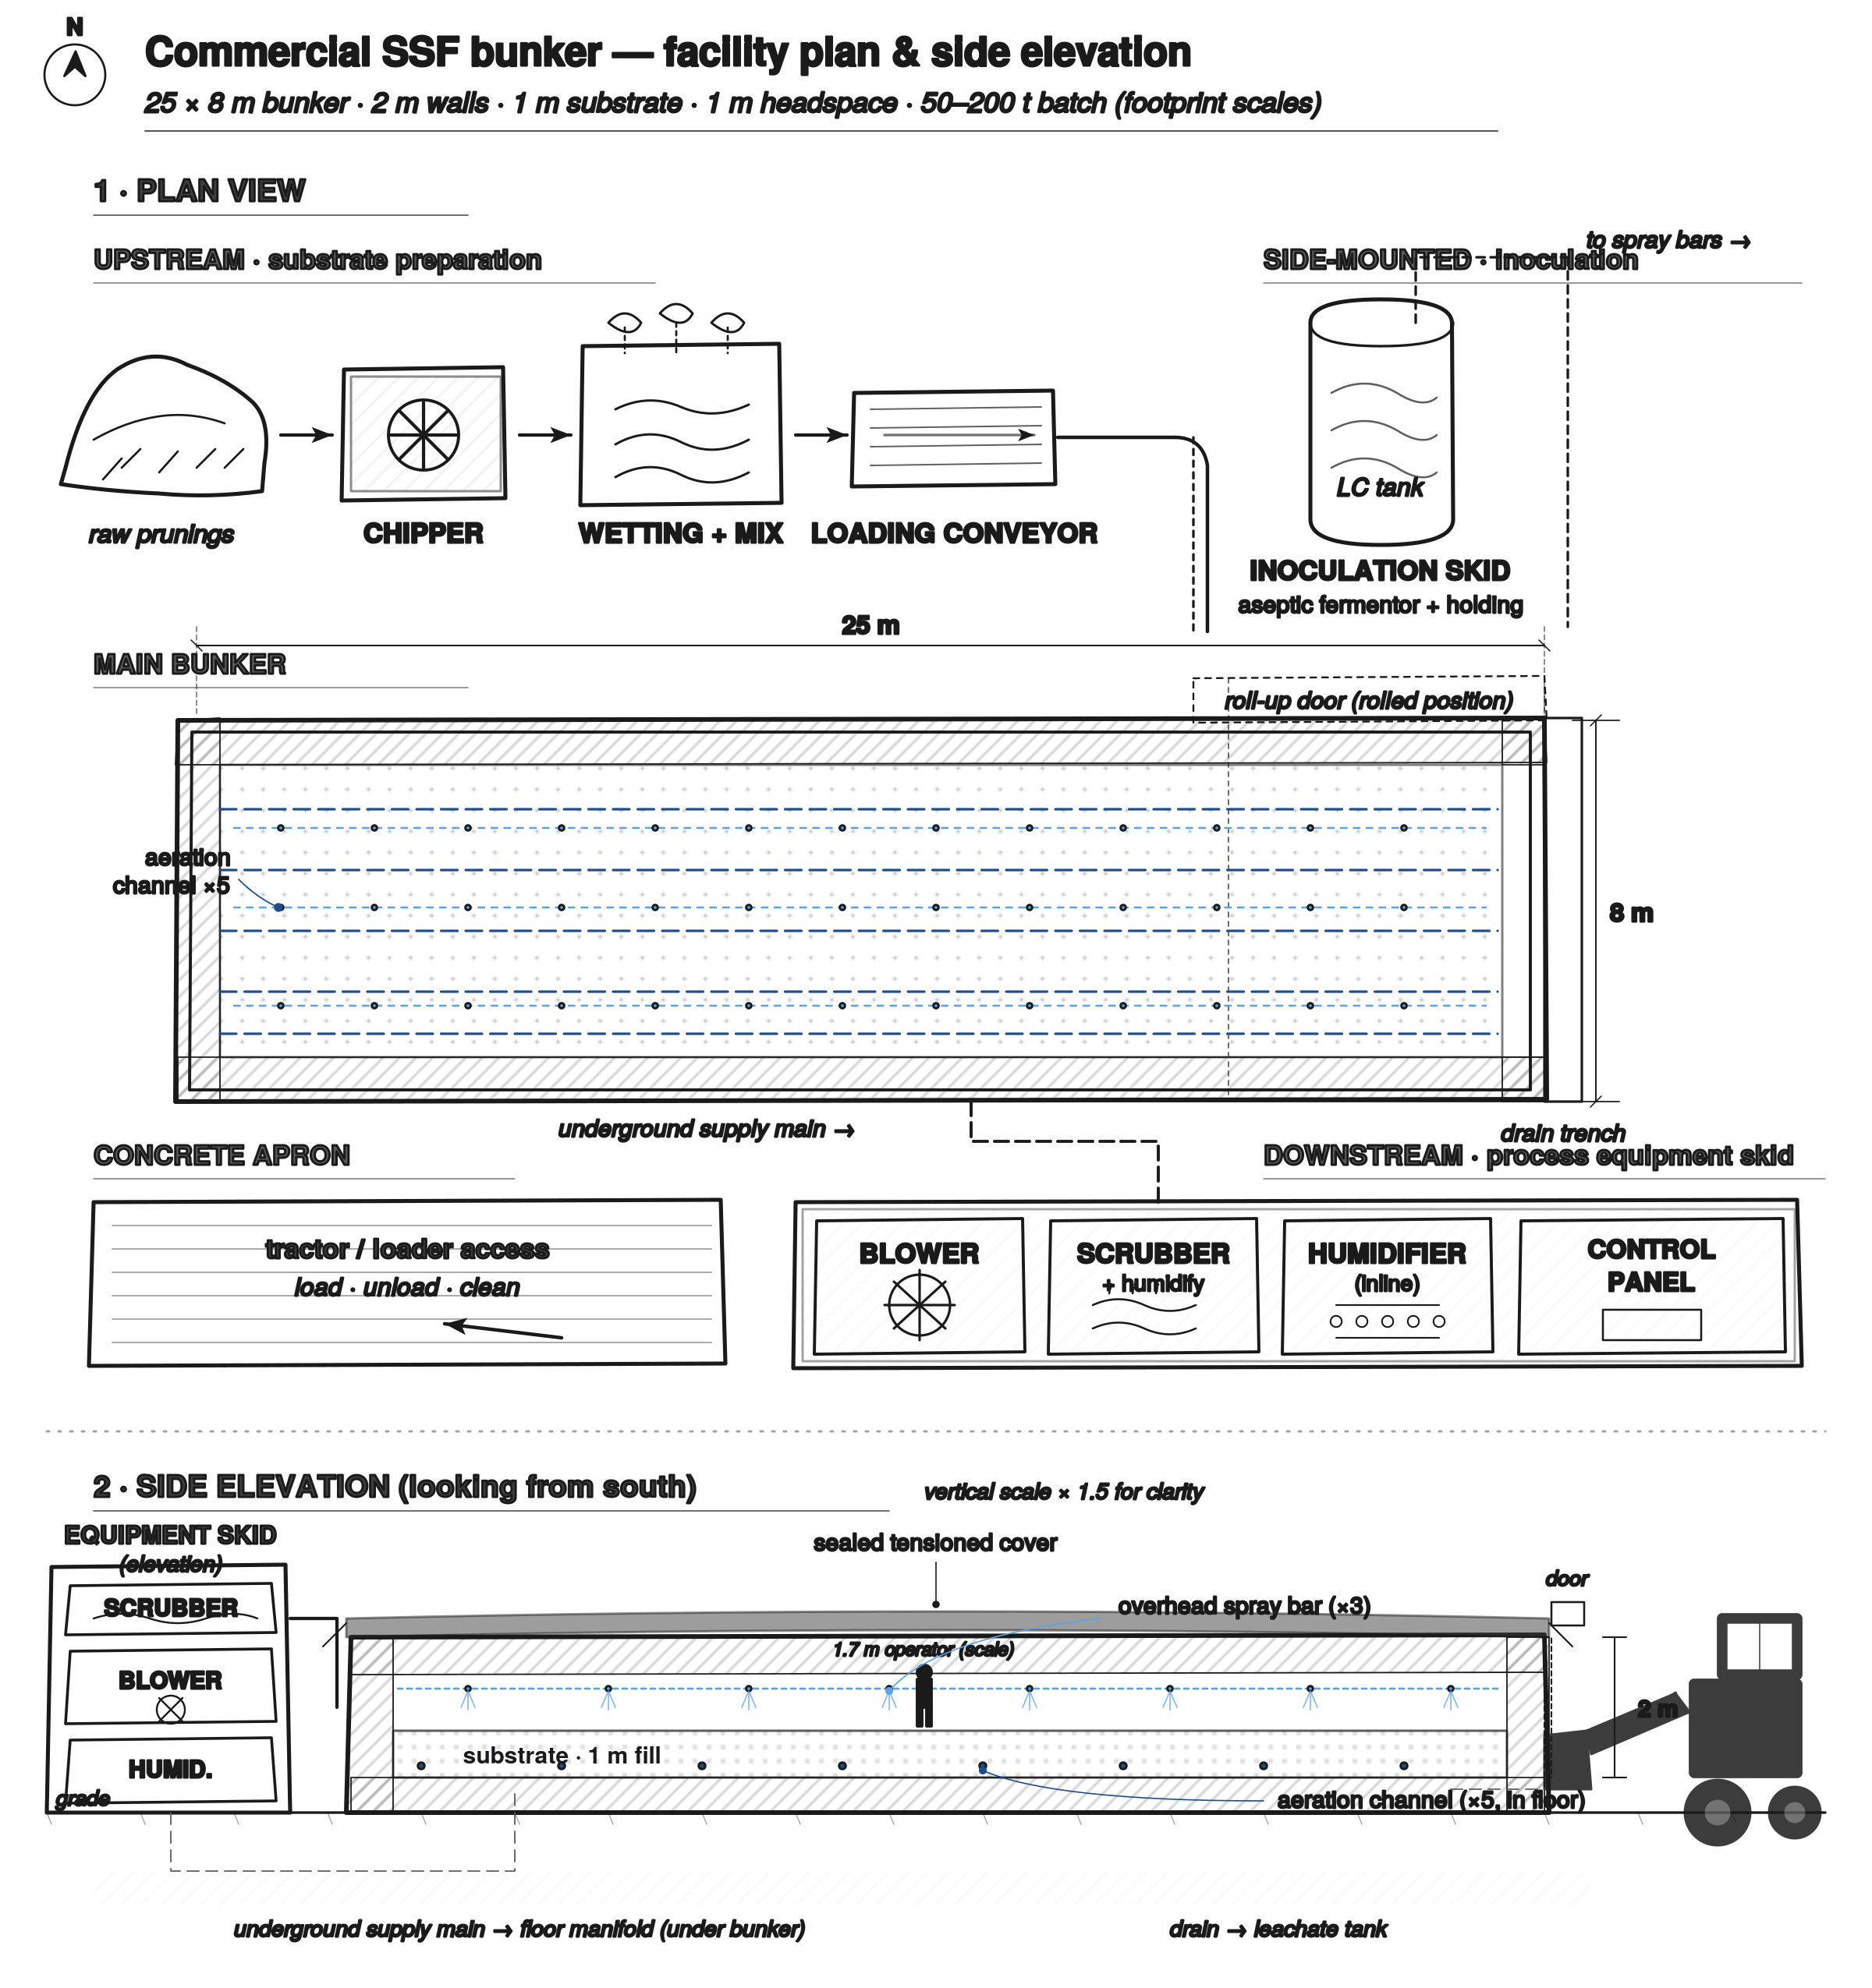
BioMill Galilee — Commercial SSF Bunker
Facility plan & side elevation · 25 × 8 m bunker · 1 m substrate · 50–200 t batch capacity
BioMill Galilee Ltd. · Pini Marco · Erez Ashkenazi · Confidential

Slide 17
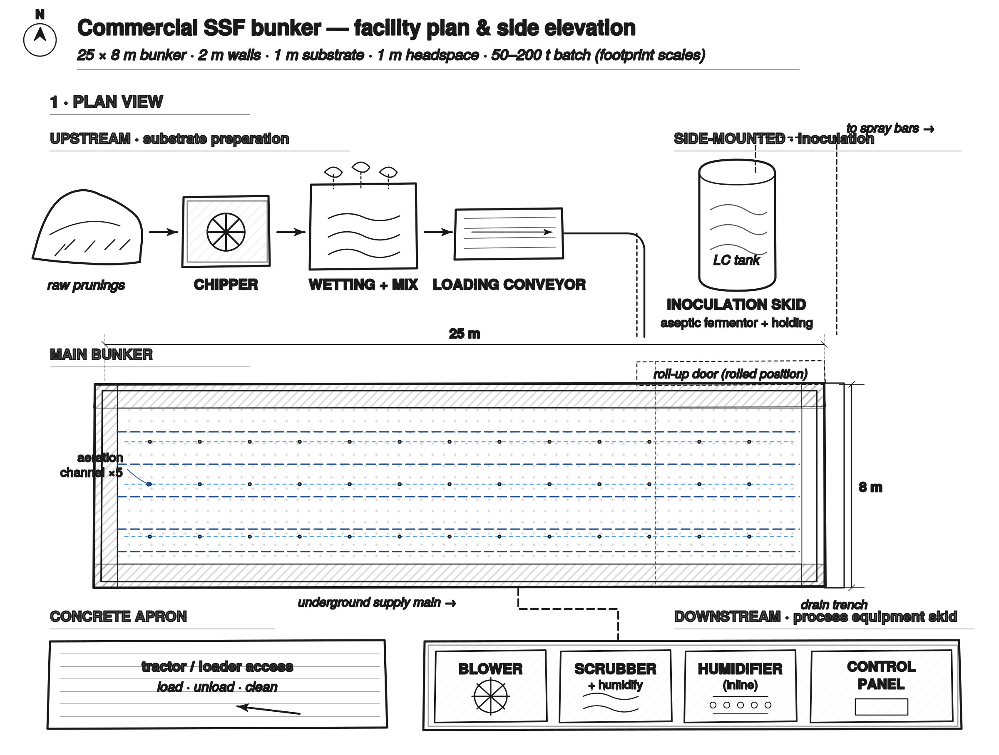
Plan view (top)
25 × 8 m bunker · substrate prep upstream · inoculation skid on side · equipment skid downstream · concrete apron
BioMill Galilee Ltd. · Pini Marco · Erez Ashkenazi · Confidential

Slide 18
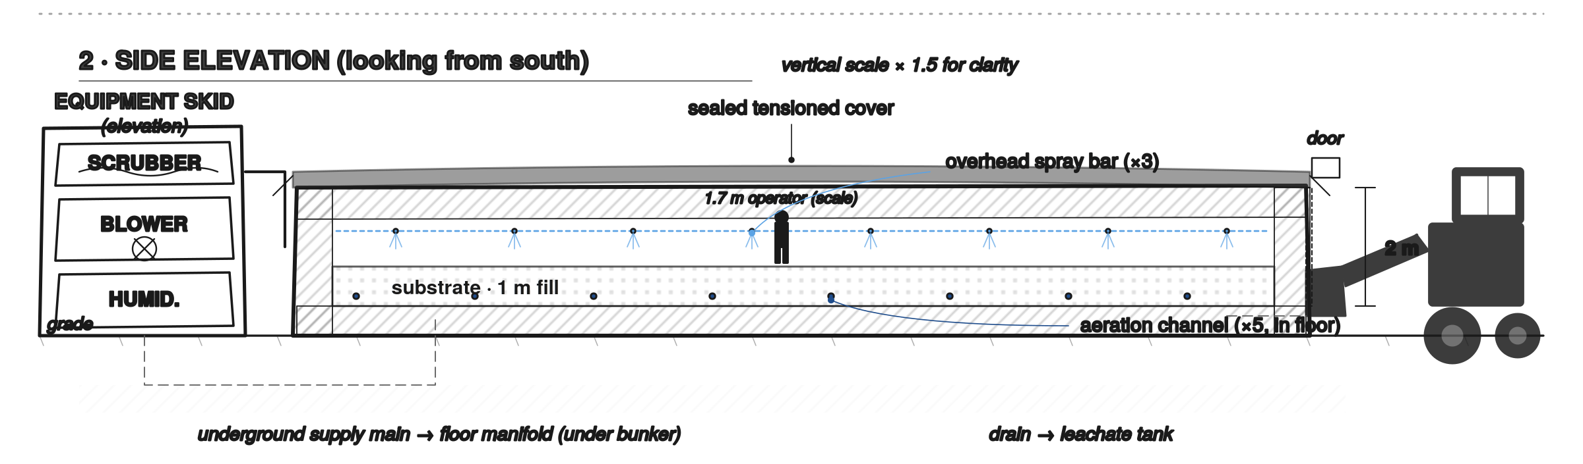
Side elevation (looking from south)
Cover, equipment skid in elevation, overhead spray bars, in-floor aeration, underground services, tractor access
BioMill Galilee Ltd. · Pini Marco · Erez Ashkenazi · Confidential

Slide 19
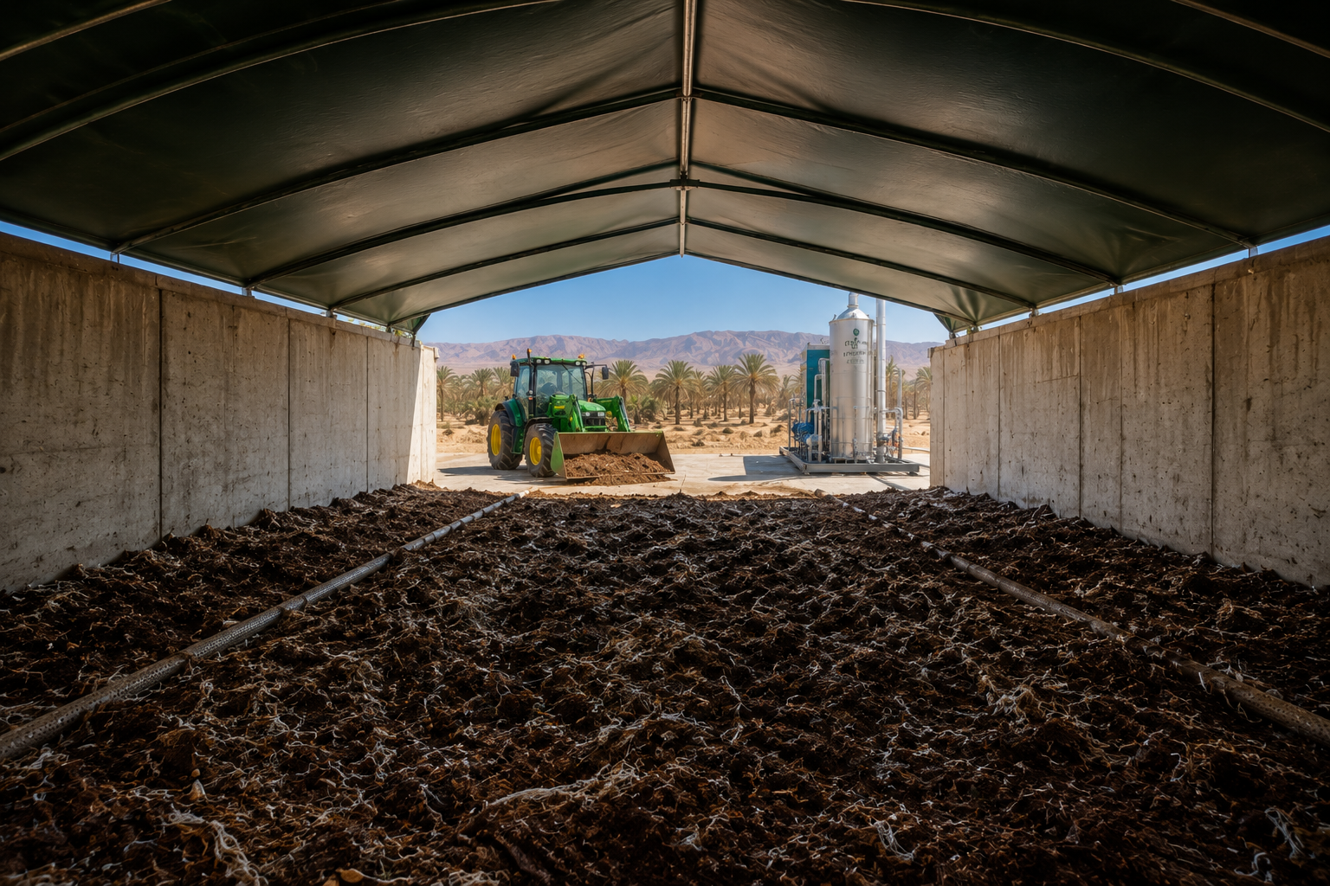

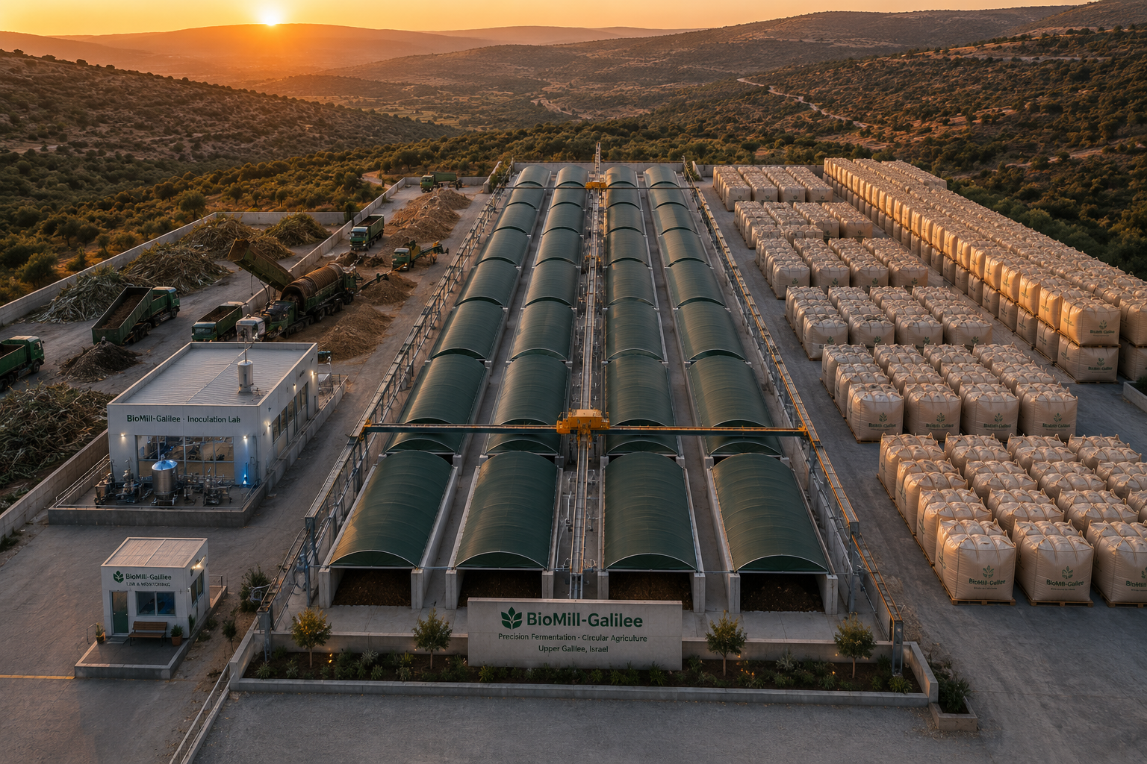
BioMill Industrial Unit Illustration

